Slide 1

May 5, 2020

Slide 2

VISION
Recruitment/enrollment
Student success
Telling our story
Positioning ourselves for the future

Slide 3

COVID
Disruption
Spring semester
Commencement
Summer/Fall

Slide 4
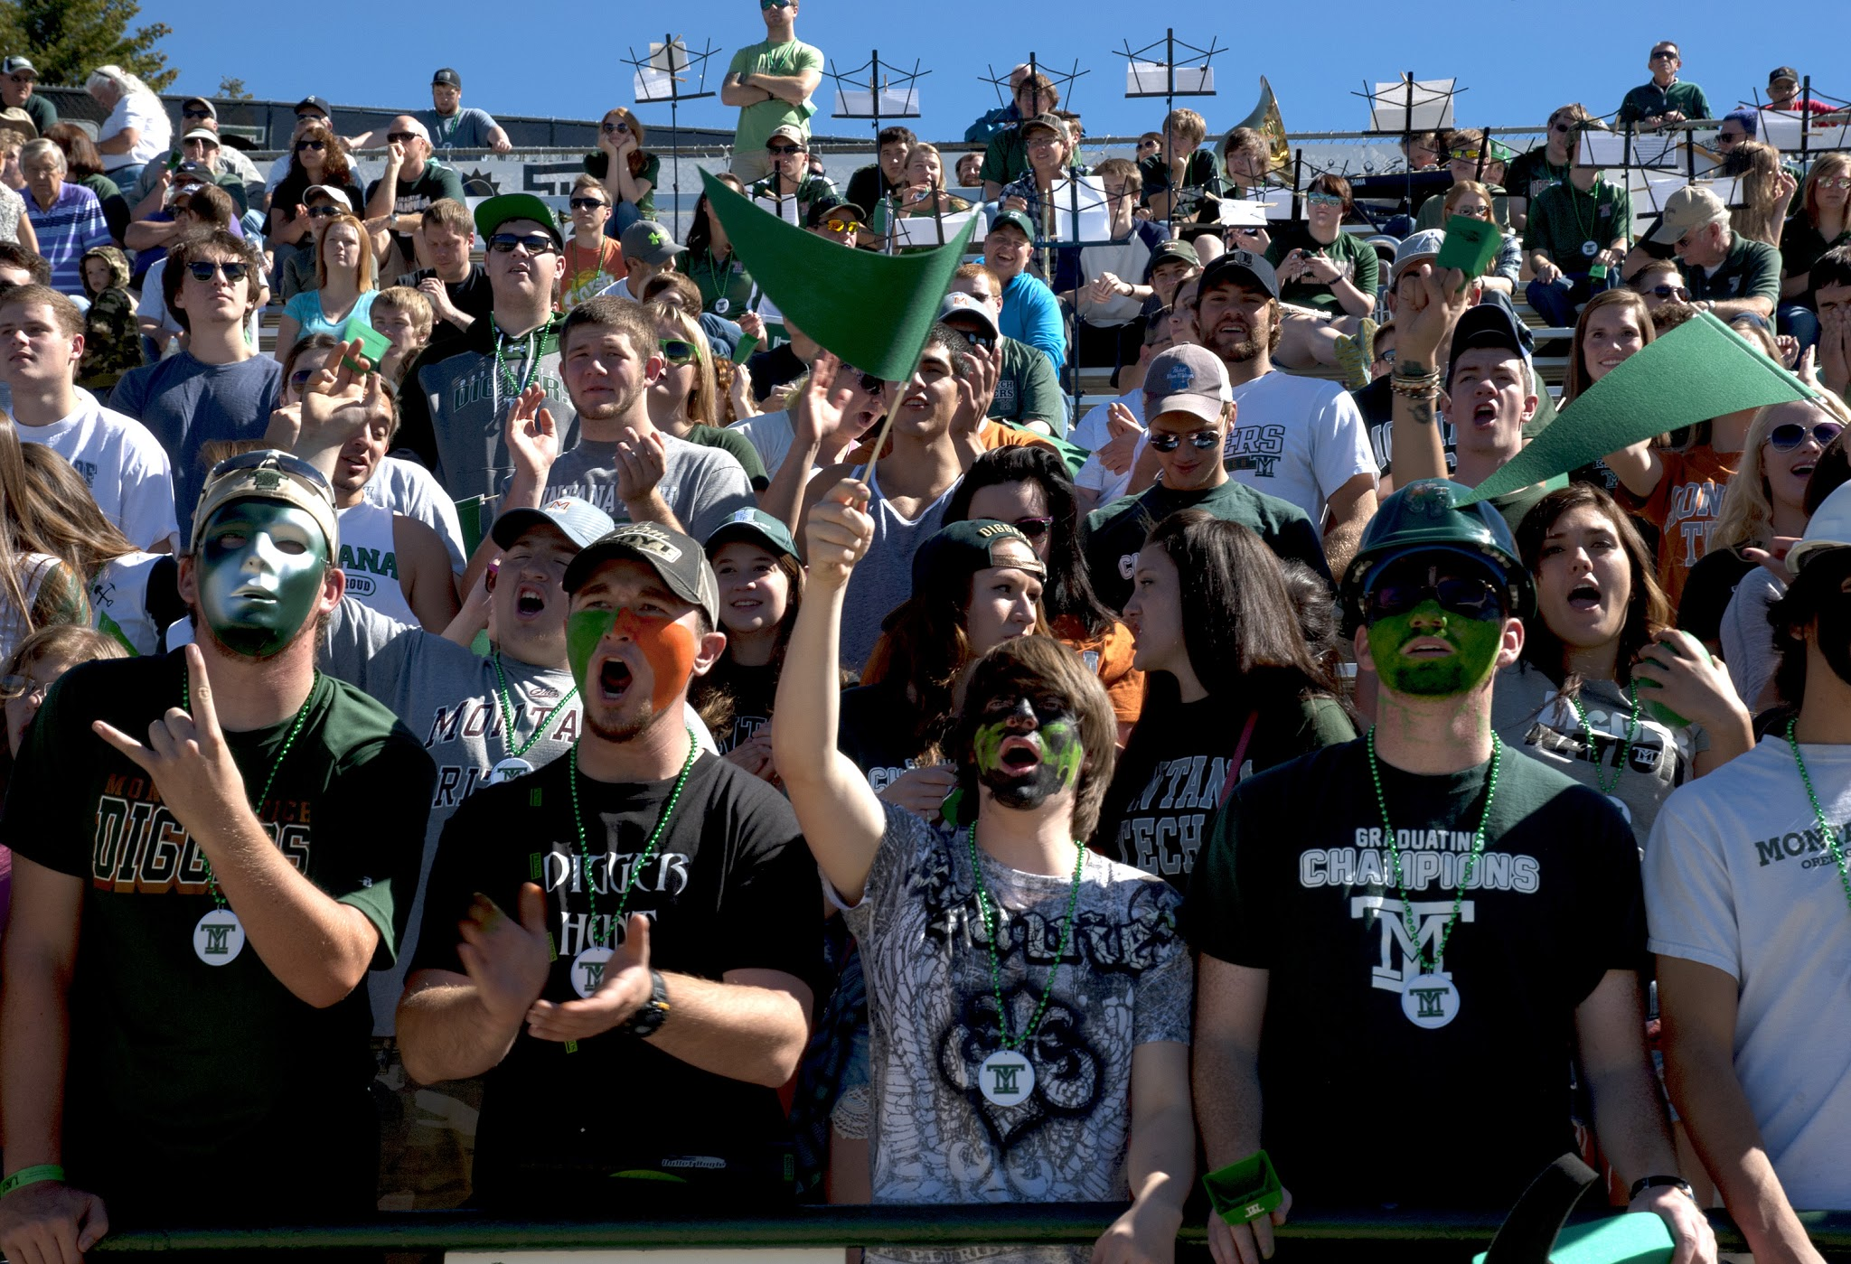
Enrollment Update

Slide 5


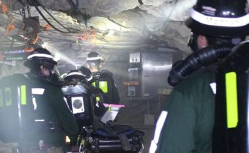
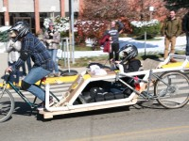
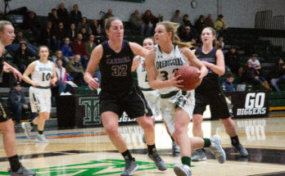
Undergraduate Admissions
Applications
Montana
Yield

Slide 6




Undergraduate Enrollment
74% Continuing
Registered for F20
Non-Resident (International)
Potentially a 33% decline F19 to F20
Fall 2020
Enrollment

Slide 7



RNL Update
Fall 2021
Enrollment Recovery
Plan
Search Engine
Optimization
FinAid Solutions

Slide 8

BUDGET UPDATE

Slide 9
FY 2020 BUDGET
Tuition Revenues were down by $800k
Revenue shortfall will be offset by-
$250K Budgeted Enrollment Contingency
$260k Identified Salary/Operational Savings
$290k Additional Salary/Operational Savings & Reserve Revolving Account

Slide 10
FY 2021 BUDGET
ENROLLMENT PROJECTIONS (on-going analysis through July)
ENROLLMENT PROJECTIONS DETERMINE TUITION AND FEE REVENUE
Resident
Non-Resident
WUE
Undergraduate
Graduate
BUDGET PLANNING GROUP
Weekly meetings
Review and establish preliminary budgets
UNKNOWNS
COVID-19 impact on university budgets

Slide 11
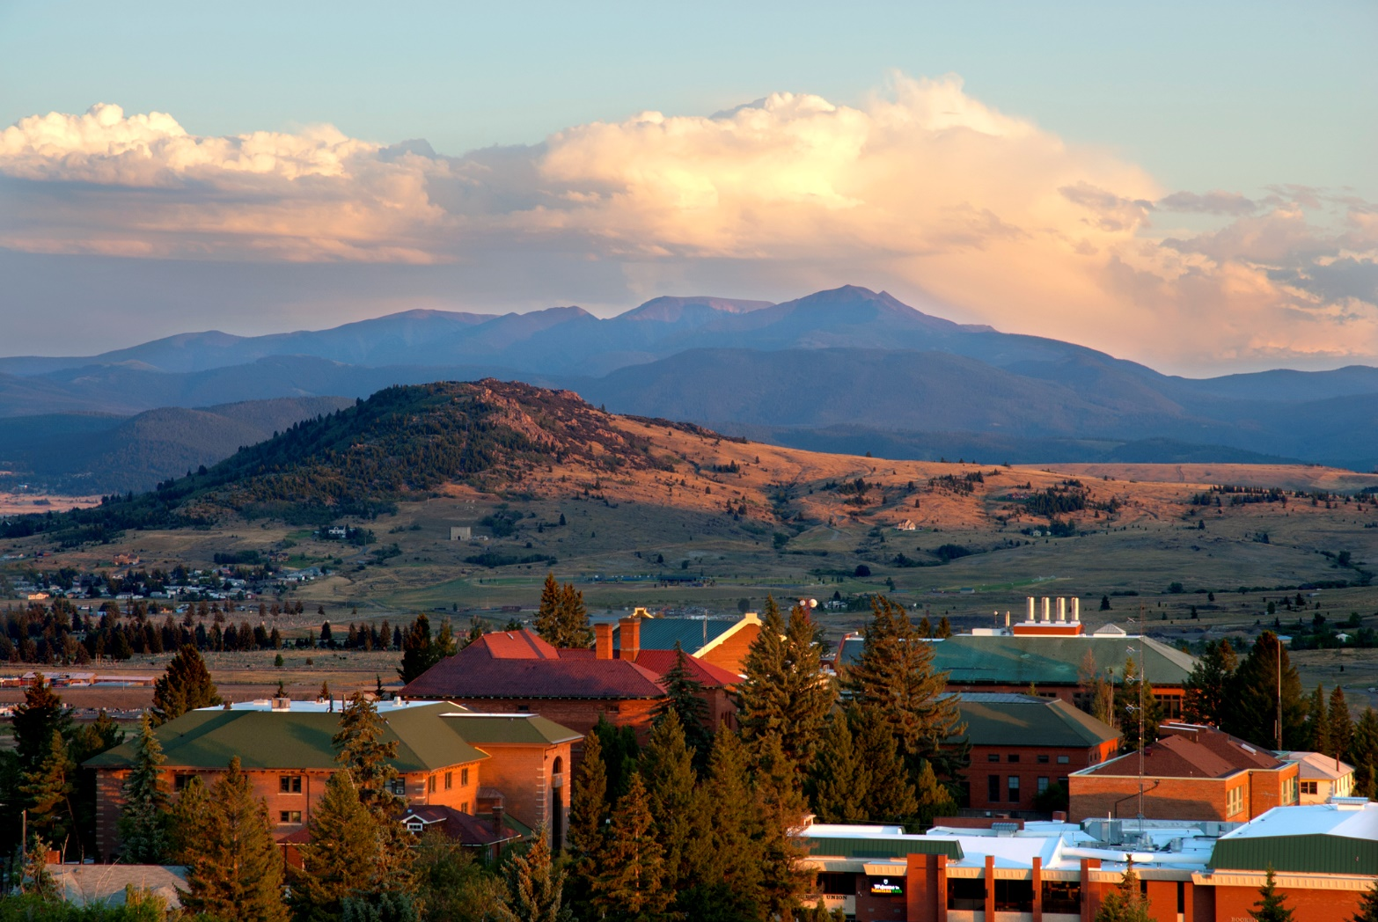
Team Reports & Recommendations

Slide 12
Undergraduate Recruitment Team Report
Efforts center around 7 key themes:
Funnel Development
Admissions Communications
Recruitment Territory Management
Organizational Structure and Operations
Campus Visit/Event Programming
Financial Aid/Scholarships
Pipeline Programs (Dual Credit, 2+2 Programs, etc.)

Slide 13
Committee
Julie Hart
Amanda Badovinac
Bernie Phelps
Shauna Savage
Ryan Mulcahy
Curtis Link
Stella Capoccia
Leslie Dickerson, Chair

Slide 14
Student Success Team Report
Summary of what we do
Effect of recommendation at other institutions
Different options for implementation

Slide 15
Recommendations
Utilize Case Management Approach for Student Success
Create advising processes and training
Utilize automated nudges
Create meta majors
Financial incentives for reenrollment
Create structured opportunities for student/faculty interaction
Create a Summer Bridge Program for at-risk students
Create institutional supports for instructional improvement
Address end of semester stress

Slide 16
Committee
Steve Gammon, Provost and VCAA
Hilary Risser, Professor and Department Head, Mathematical Sciences
Katie Hailer, Associate Professor and Department Head, Chemistry
Amy Lorang, Counselor/Disability Services
Mary North Abbott, Associate Professor, Petroleum Engineering
Akua Oppong-Anane, Assistant Professor, Freshman Engineering
Dario, Prieto, Assistant Professor, Mechanical Engineering

Slide 17
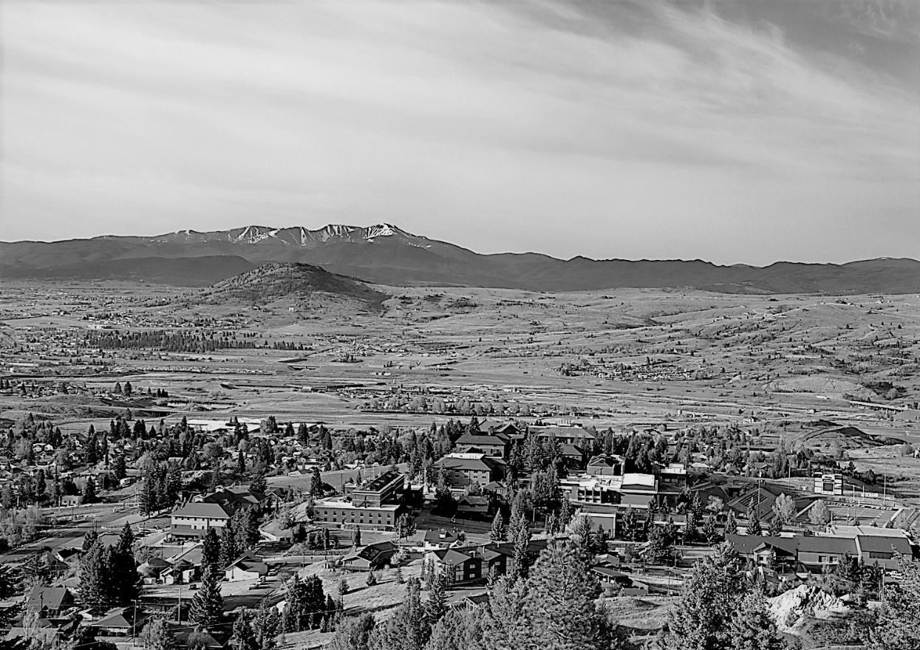
Marketing Communications Team Report
Shannon Panisko - Chair
Jenna Bolstad
Benjamin Malouf
Scott Rosenthal
Kyle Samson
Glen Southergill
Hattie Thatcher
Todd Tregidga
Jon Wick

Slide 18
Marketing Communications Team Review
Website
Social Media
YouTube
Campus Engagement
Community Engagement
MNews

Slide 19
Campus Refresh & Space Planning Team Report
Charge - Lead a space audit to identify campus infrastructure needs as well as an assessment of usage capacity with the goal of creating efficient and effective use of existing campus space.
Focus on “Refresh”
Seeds for “Strategic Plan” and “Facilities Master Plan”

Slide 20
Committee
Michael Barth
Marissa Bentley
Stephanie Cook
Matt Donnelly
Scott Forthofer
Brian Kukay
Nancy Oyer
Robert Pal
Bill Ryan
Ricardo Sanon
Rita Spear
Dan Trudnowski (Chair)

Slide 21
Content
Planning for a “Facilities Master Plan”
Strategic planning considerations
Landscaping refresh
Building-by-building refresh

Slide 22
Facilities Master Plan
Comes from the Strategic Plan - ALL buildings need a mission
Utilizes design guidelines and standards
Academic guiding principles
ADA compliance – put students first
Synergistic groupings of academic programs
Undergraduate student experience
All programs need a home near faculty & labs
Dispersing lecture halls will enhance student interactions across programs
Graduate student experience
Priorities depend on nature of research
Non-academic guiding principles
Create student-focused center and build out (Mall)

Slide 23
Strategic Planning Considerations - Top 10 List
ADA compliance for ALL teaching labs.
Synergistic groupings of academic programs.
The following appear to be poor groupings:
Main Hall: Elect Eng and Liberal Studies
ELC: Business, Geop, and Met Eng
Match program space allocation to enrollment and labs.
Allocation has not matched program growth/shrinkage over past decade.
Examples: Mech Eng, Civil Eng, OSH, Pet Eng
Where is the long-term home for Highlands College?
Where is the “student center” of campus?
The Mall should be the starting point
We suggest the SUB become 100% student focused
Meeting and Conferencing be moved to SSC
Where is the long-term home for campus administration?
We suggest Main Hall or Mill be considered. Connected to campus center.
S&E over crowding
ME, CE, OSH, EnvE, and Nursing all have ownership & use of space. This building cannot adequately house all of these.
Co-locating faculty with teaching labs
ME and EE labs are in NRRC, offices are far away. Move these programs close to their new labs.
Re-locate facilities to the campus perimeter.
Facilities is currently located near the campus center. The space should focus on the student.
Beautify the library auditorium to be a community showcase

Slide 24
Landscape Provides the Initial Perception
of Our Campus
We need a Landscape Master Plan and Standards
Consult an expert in Landscape Design & Planning
Immediately address safety issues caused by trees, sidewalks, and shrubbery
Determine which areas are student-centric and make them hospitable and inviting
The Mall should be the center

Slide 25
Building-by-Building
Refresh
Report did a building-by-building audit resulting in “refresh” recommendations
E.g., Lighting, carpet, painting, signage, housekeeping
We recommend top 10 list be immediately considered

Slide 26
Concluding Remarks
The Mall should be the student center of campus. Work out from there.
Tech does NOT need more academic buildings and space. We need to better utilize what we have.
We desperately need a Facilities Master Plan and Standards.
What’s the future mission for Engineering Hall?
Some of our “Strategic Planning Considerations” should be immediately implemented.
Landscaping – Re-design the Mall.
Immediately address program homes for those in Main Hall, S&E, NRRC, and ELC.

Slide 27

WHAT DOES SUCCESS LOOK LIKE?
Robust enrollment structure & plan in place
Student success/increased retention
High impact marketing/branding campaign developed and deployed
Provost and VC Administration & Finance searches completed
Successful ABET accreditation visit and Northwest Commission mid-cycle review
Approval of two new PhD programs
Funding secured and plans implemented for Nursing Simulation Center
Fiscally sound/balanced budget
Clear and consistent campus communication
Completion of campus space audit with progressive/action driven recommendations

Slide 28

Our Success Now!
Extraordinary Sense of Team
Online Success
Community Support
DiggerCon/Tech Days
Athletics Stories
Volunteer Engagement
Covid19 Team
Recovery Team
“Can do” Attitude

Slide 29
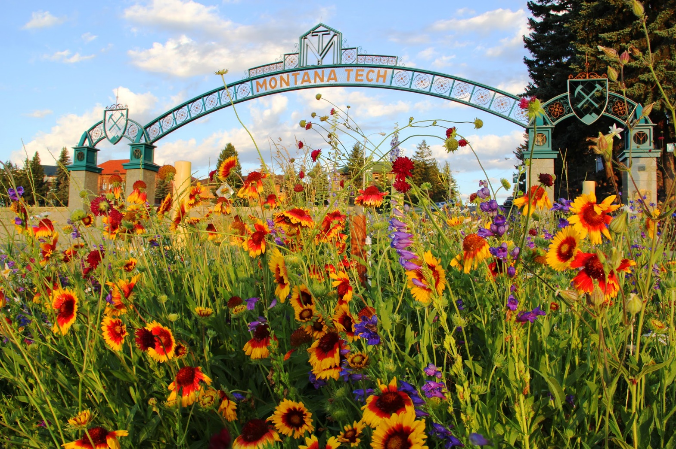
Thank you

